Slide 1
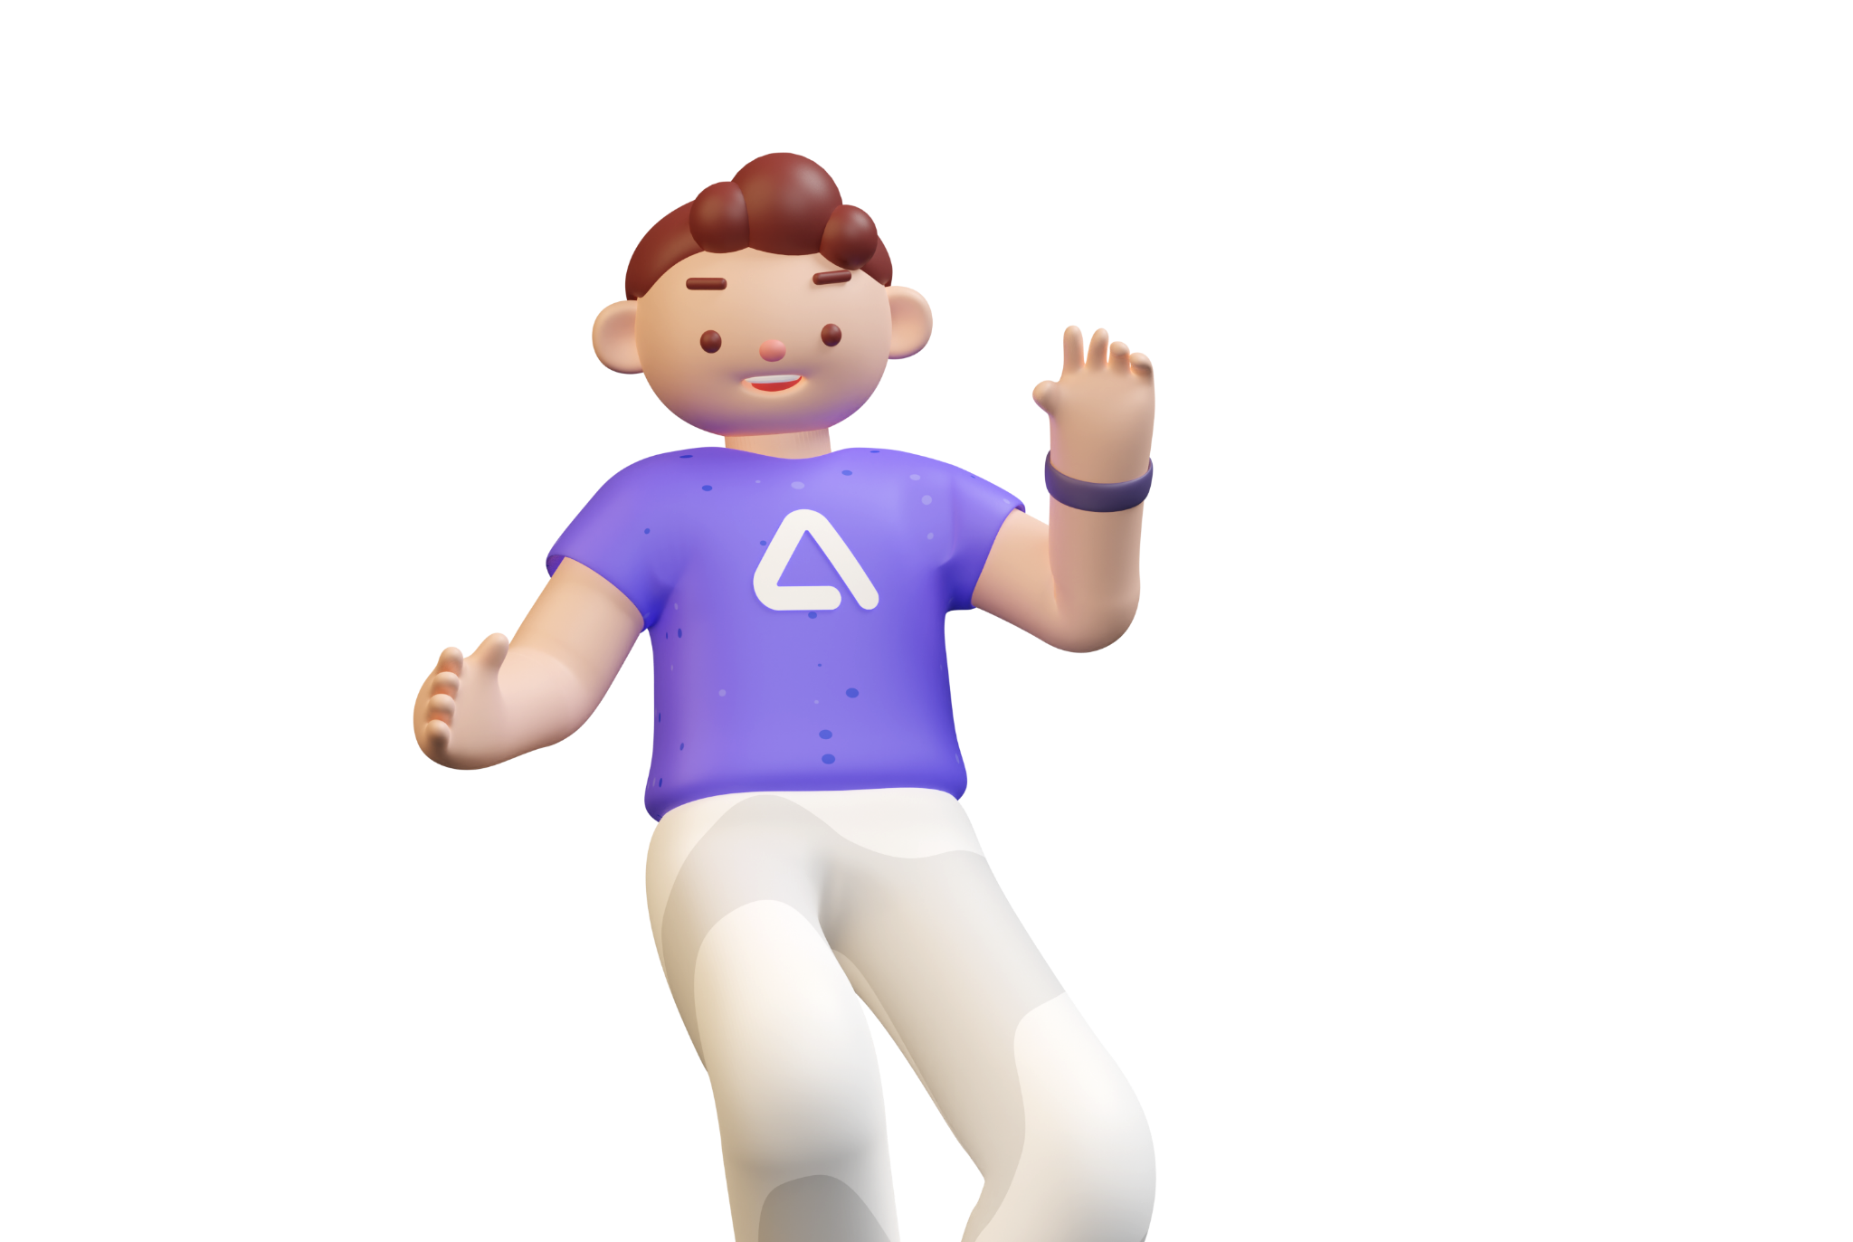
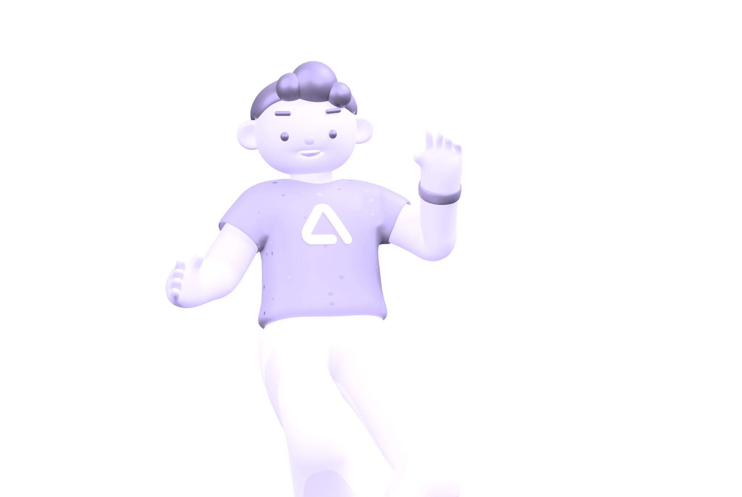
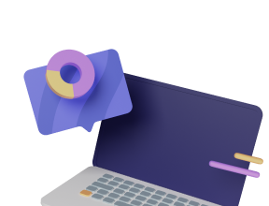

Medicare
By TeamBeta

Slide 2
Table of Contents
Project Medicare
Motivation
App Purpose
Expected Users
Use case Diagram
Main App Functionalities
• Clinic Search
•Medicine Search
•Medicine Reminder
•User Account
Live Demo
By TeamBeta

Slide 3
Project Motivation
COVID-19 situation
Aging population
Healthcare concerns becoming a more salient part of many people’s everyday lives
Difficulty securing appointments with doctors and clinics

Slide 4
App Purpose
Intended Users
Medicare is an all-in-one app that helps individuals source all the help they need with respect to getting in touch with doctors and clinics, as well as manage their self-medication.
Busy adults
Elderly and their caretakers
People with disabilities
People with health problems

Slide 5
Main Functionalities
Search for nearby clinics
Search for medicine
Set and manage medicine reminders
User account

Slide 6
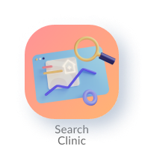
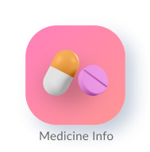
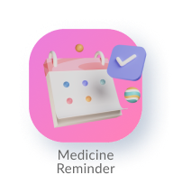

Main Functionalities
Search for clinics
Search for medicine
Set and manage medicine reminders
User account

Slide 7
Use Case Diagram

Slide 8
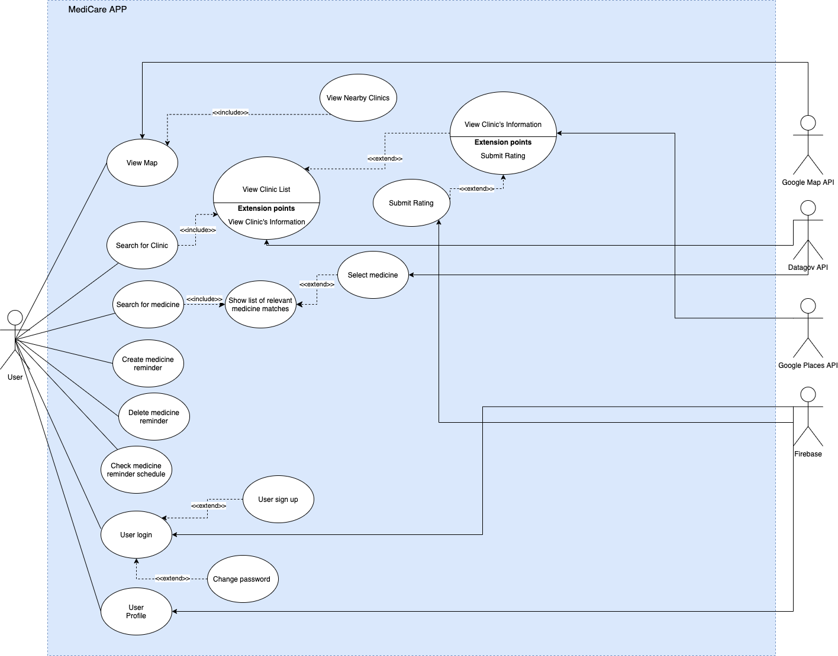
Notes:
Search for clinic include viewing map to see nearby clinics and searching for clinic by name, the user may also click into a clinic to view more information about it, as well as submit a rating for that clinic that will be stored in their user account. The list of clinics and their info, such as name, address, opening hours, contact number and website, is obtained from an api from datagov and Google places, while the map display uses google maps api.
Search for medicine includes searching for a particular drug via its name or any of its attributes, including manufacturer, ingredients and dosage form. The medicine info is also fetched from a datagov api and the local database is refreshed to be up to date with the API everytime the user opens the app.
The user is also able to create, edit, delete and view medicine reminders, as well as log in, create a new account, change password or log out.

Slide 9
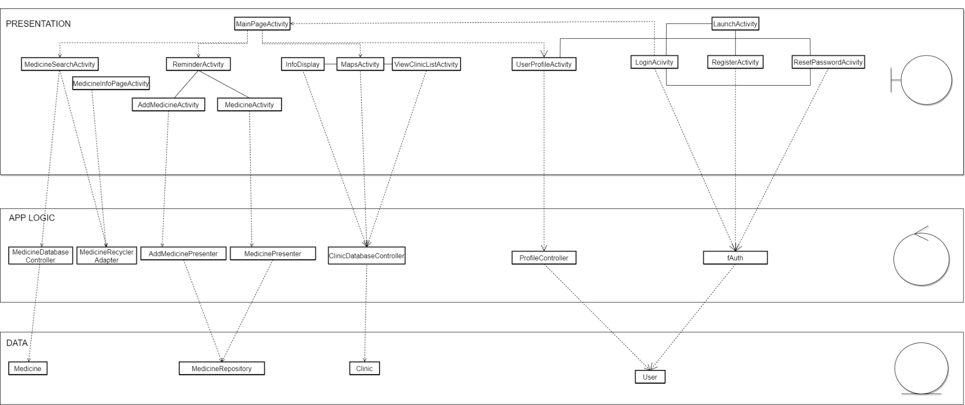
Notes:
The overall design principles we implemented where the
Separation of Concerns and Single Responsibility Principle: Each class has only one job. Boundary classes on the first level focus on displaying UI elements and receiving user input, controller classes on the second level interact with API and database, storing info to entity classes and loading information to the boundary classes, entity classes hold the local copies of info in the app itself
This supports good testability as errors at any step usually fall under the fault of a single class and are hence easier to trace, making the software easier to maintain. The modularity of the classes also mean that classes can be reused in other potential future app functions, making for good scalability.

Slide 10
Medicine Reminder
Use Case:
Add Medicine Reminder
Notes:
Now we will explain a bit more on some of our individual use cases. The first of which is adding a medicine reminder

Slide 11
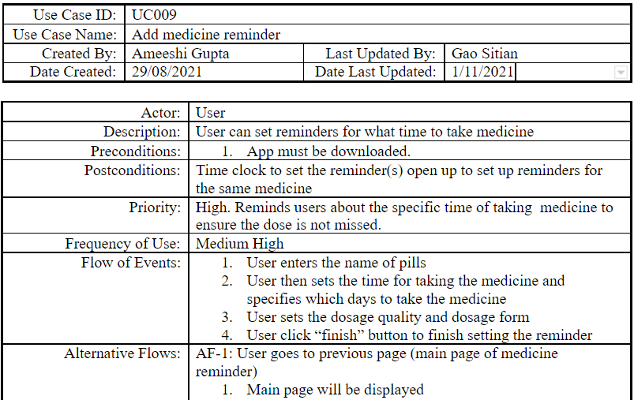
Notes:
One of Medicare’s key use cases is allowing the user to set a medicine reminder that will notify them when they need to take their medicine. The user should be able to key in the medicine name, select on what days of the week and what at what time of day they want to take the medicine, as well as the dosage type.
//The user may then save their medicine reminder. Selecting the back button on the medicine reminder creation page will not create the medicine reminder.

Slide 12

Notes:
So for example, ...

Slide 13
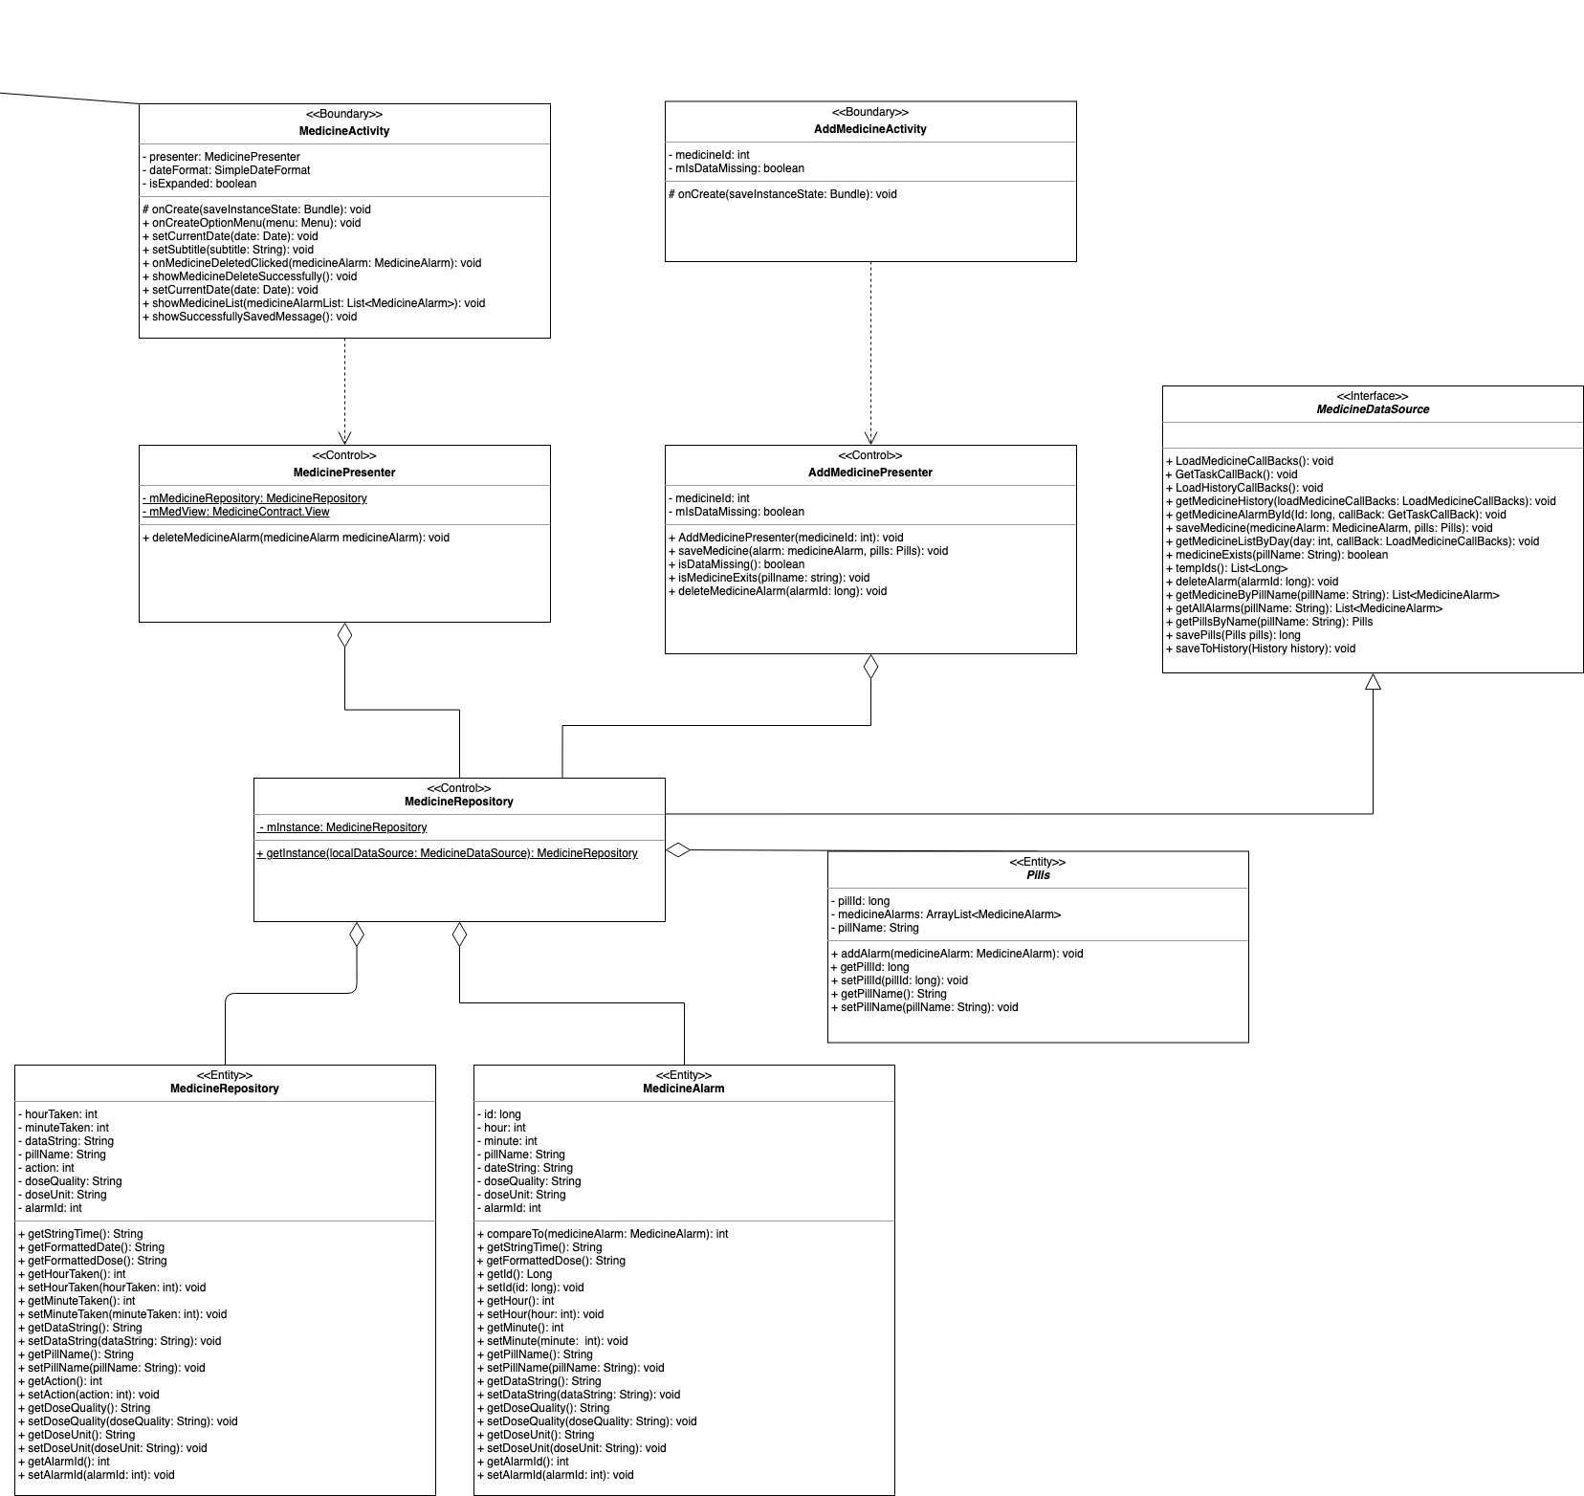
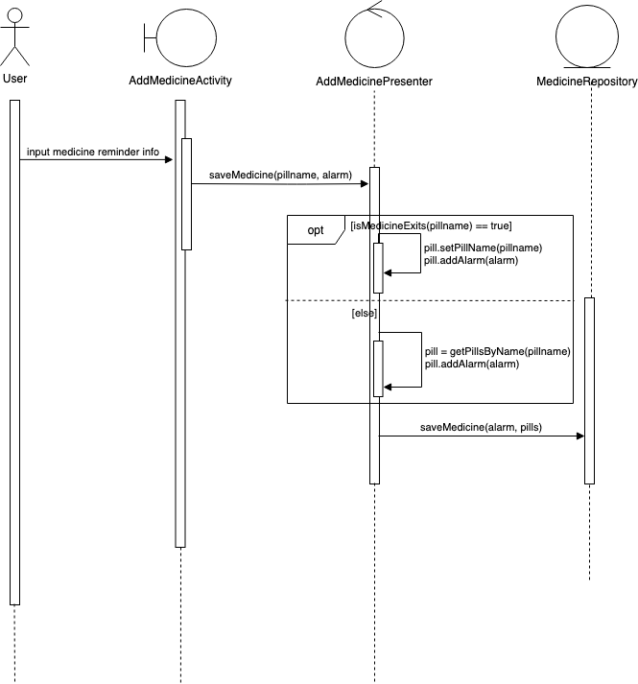
Add
Medicine Reminder
Notes:
Here is a snippet of the class diagram and user diagram of the add reminder functionality.
We implemented this functionality using the model view presenter architecture, or MVP, which is derived from the Model View Controller (MVC) Pattern. Since activity classes in android studio often handle both data and UI, it can be difficult to divide the model, view and logic from each other. MVP is able to divide view and model using a presenter as a mediator between the two, updating the view based on changes in the model.
So in this case, AddMedicineActivity is the View, AddMedicinePresenter is the Presenter, and medicineRepository is the Model. AddMedicineActivity will manage all the UI presentation and receive any input the user keys in. The medicine reminder information entered by the user is then passed to addMedicinePresenter which then stores it in medicineRepository. Thus, the functions of each class is self contained, this promotes loose coupling that makes potential future modifications easier, and because each class has only one specific function, troubleshooting is made easier and the app is easier to maintain.
/*
For the add medicine reminder use case, AddMedicineActivity is the View, AddMedicinePresenter is the Presenter, and medicineRepository is the Model. AddMedicineActivity will manage all the UI presentation and receive any input the user keys in. The medicine reminder information entered by the user is then passed to addMedicinePresenter which then stores it in medicineRepository. Thus, the functions of each class is self contained, this promotes loose coupling that makes potential future modifications easier, and because each class has only one specific function, troubleshooting is made easier and the app is easier to maintain.

Slide 14
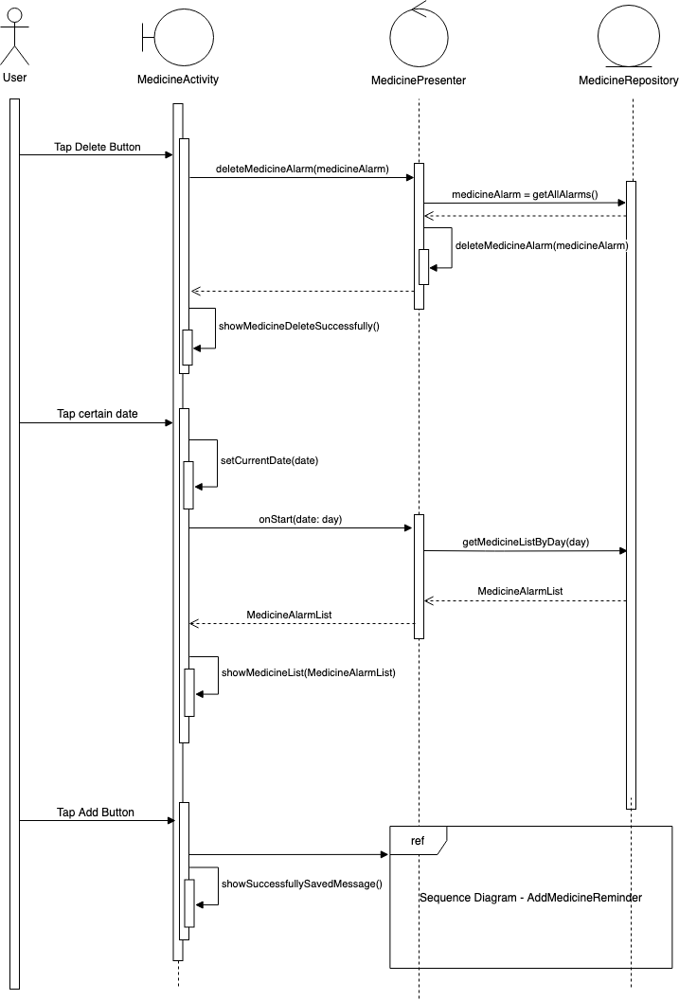
Medicine Reminder
MainPage
Notes:
The MVC Model is also similarly implemented for other medicine reminder functionalities, such as deleting existing reminders or navigating to different dates on the calendar to see different reminders on different days, where MedicineActivity is the View, MedicinePresenter is the Presenter, and medicineRepository is the Model.

Slide 15
Clinic Search
Use Case:
Search for “Fullerton”
Notes:
Next we will introduce our clinic search function. We will use an example to demonstrate our use cases.

Slide 16
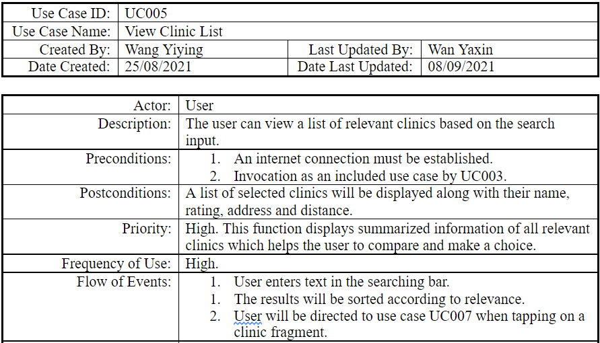
Notes:
View Clinic List is one of the most important use cases in clinic search. It allows user to view search results after he enters an input. The result will be listed by relevance. All clinics will be displayed along with name, rating, address and distance.

Slide 17
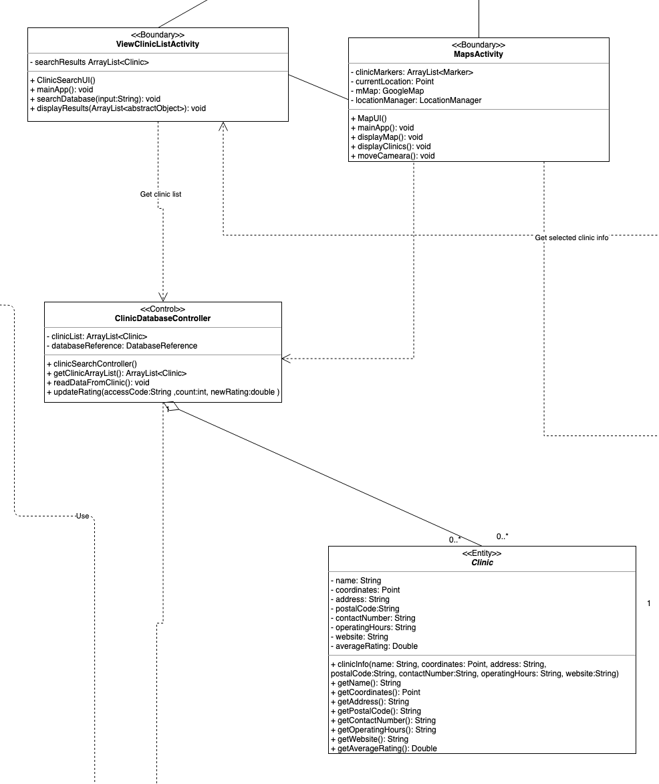
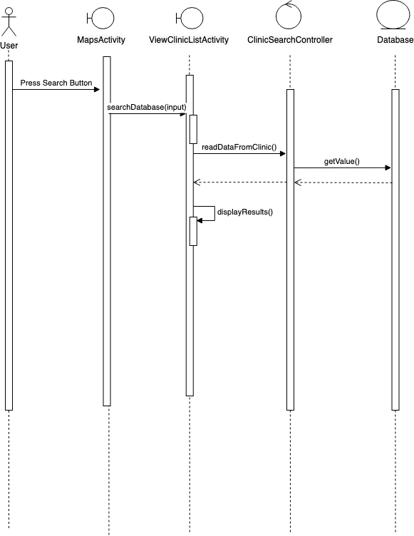

Slide 18
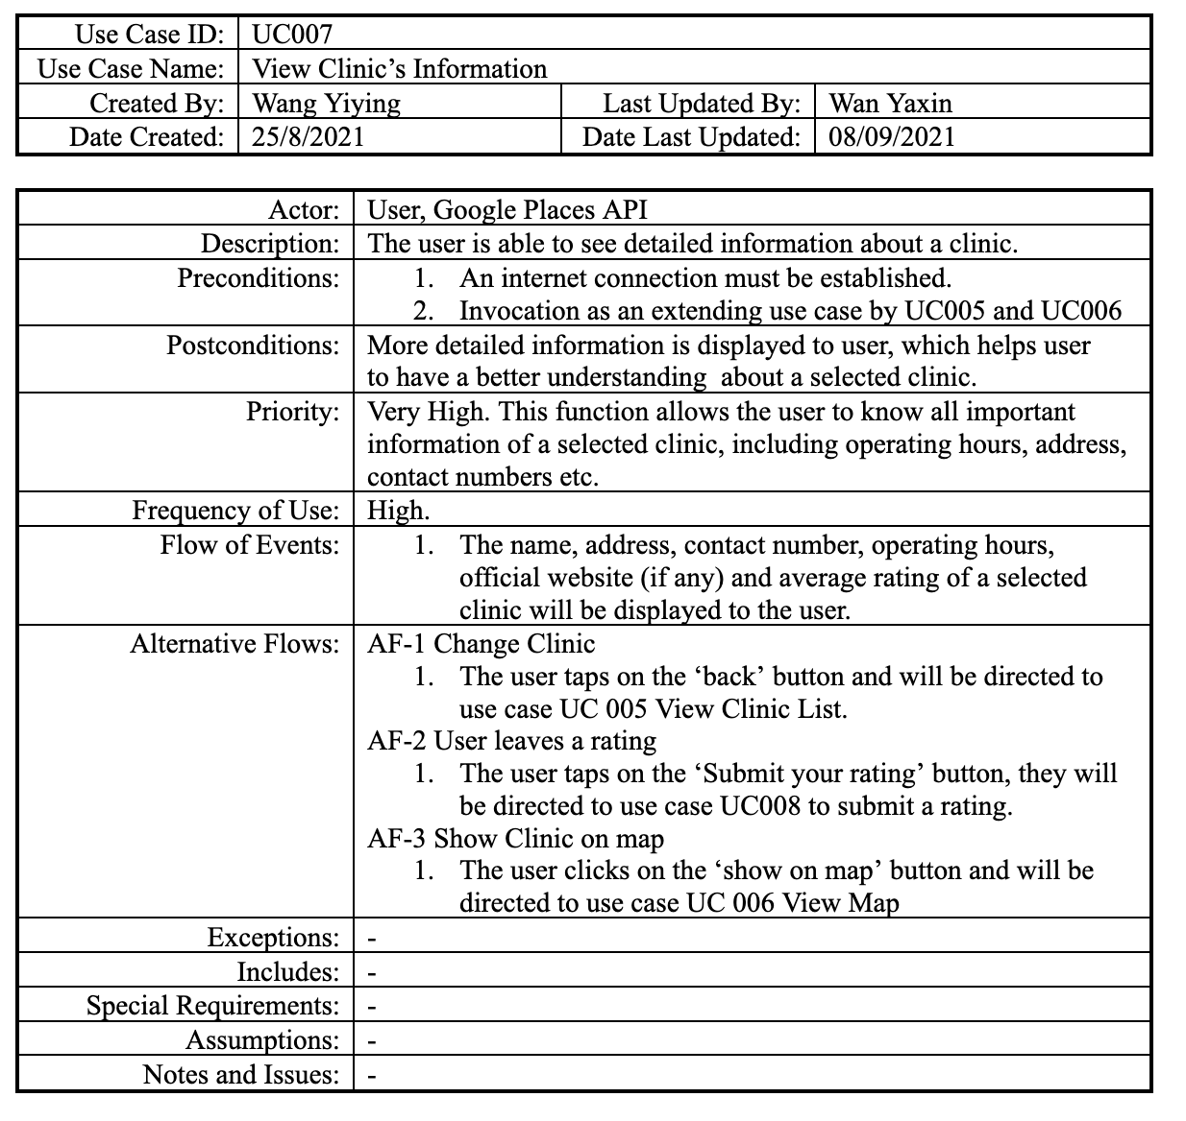

Slide 19
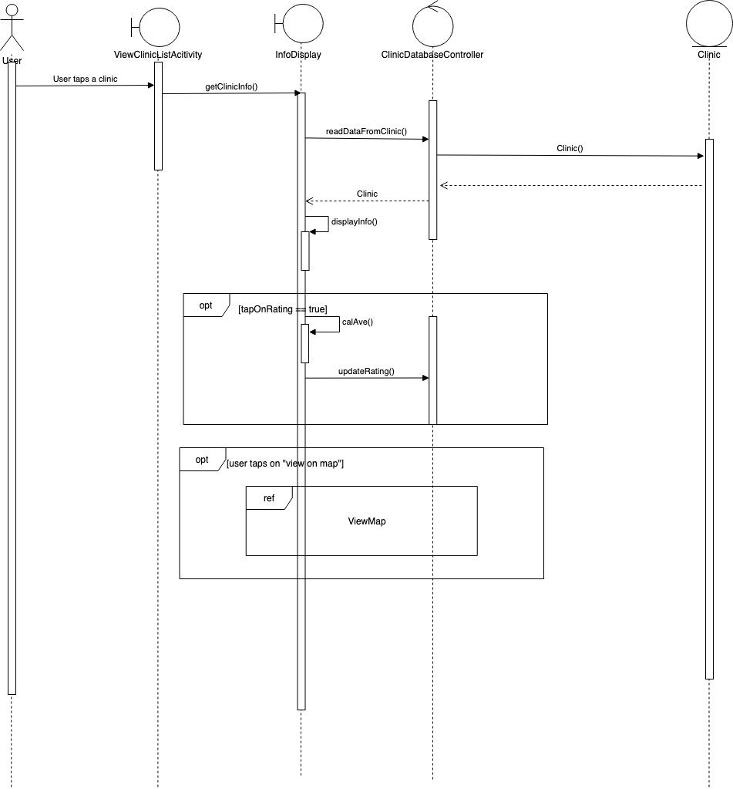
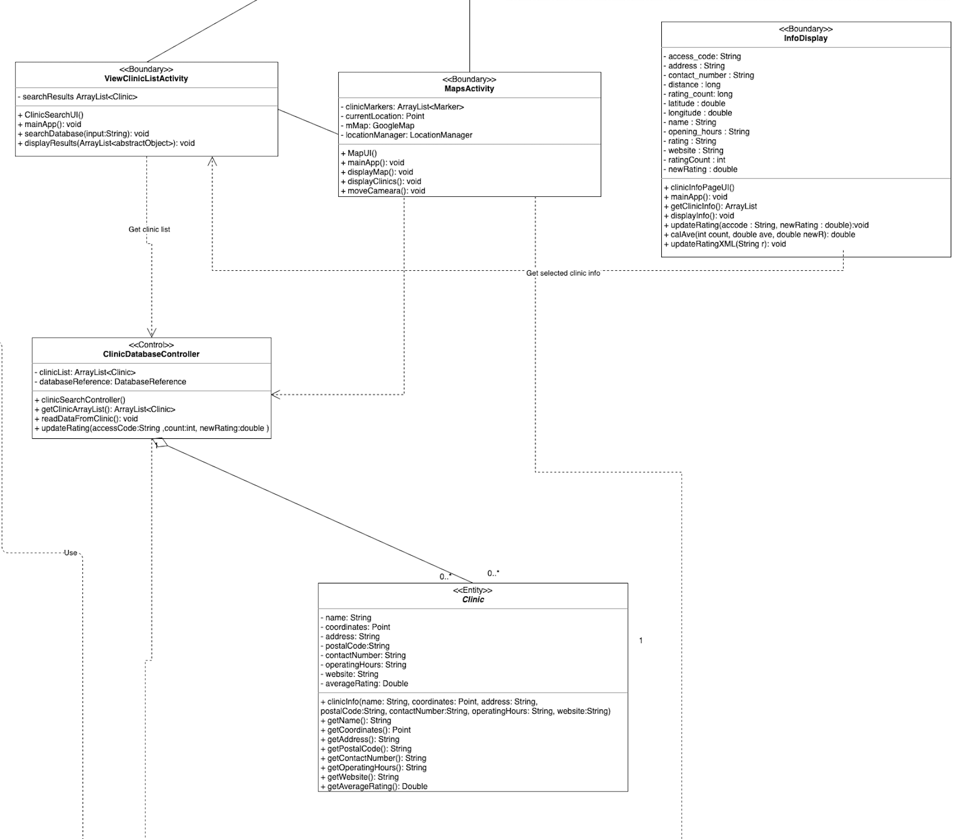

Slide 20
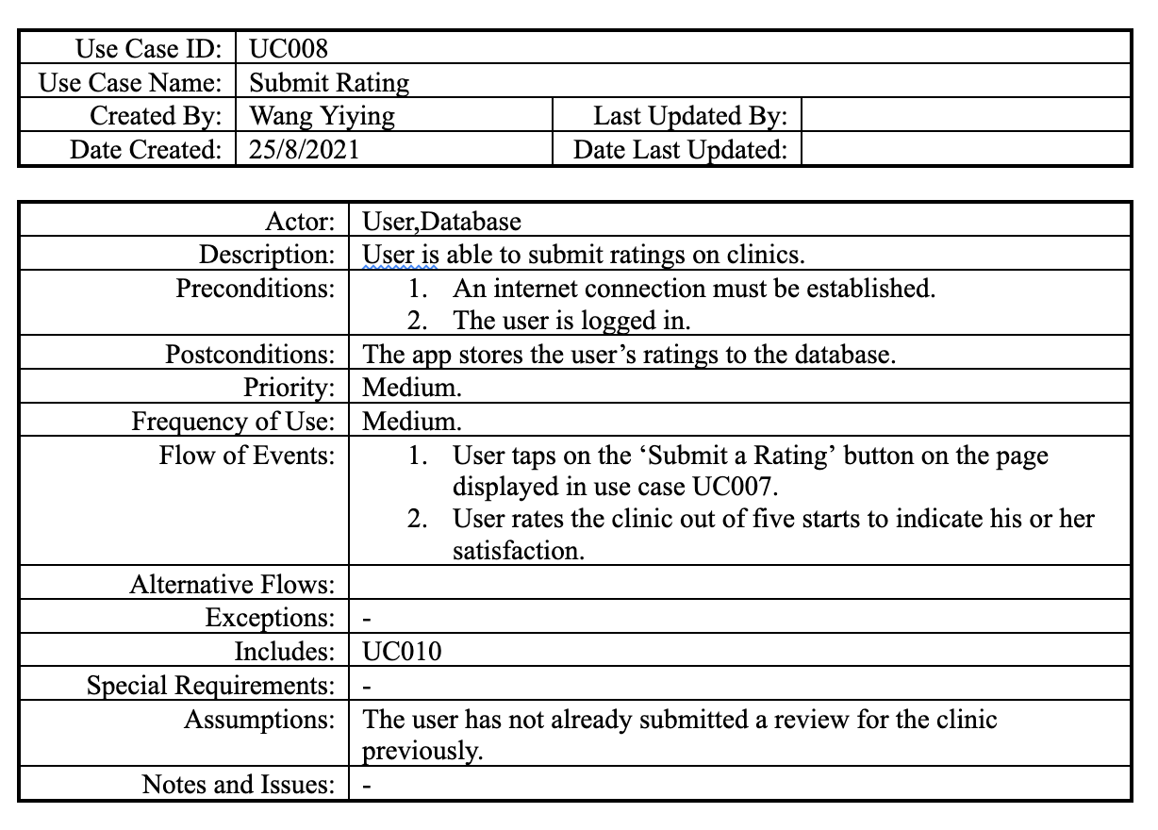

Slide 21
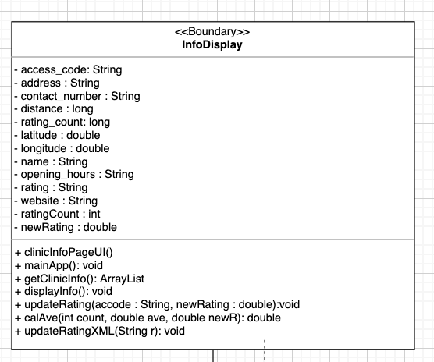
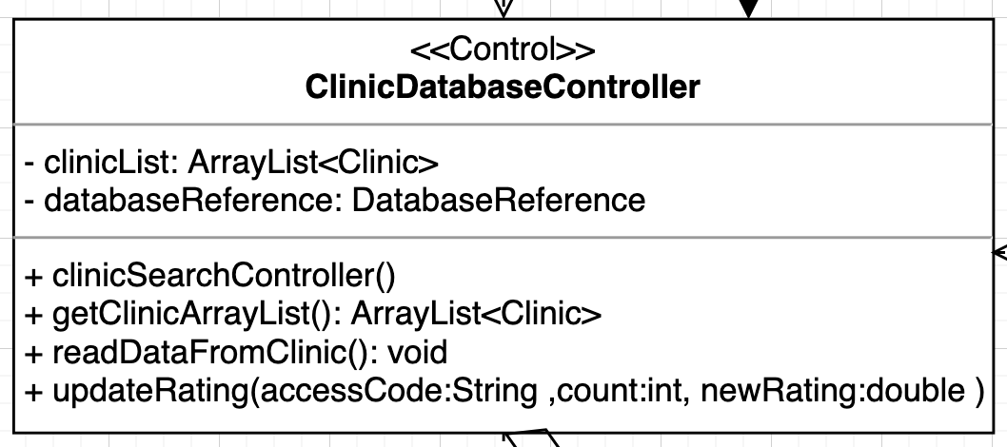
Notes:
Design pattern: observer pattern
When the user submits a new rating, the average rating of the clinic will be re-calculated. In our case, the rating being displayed on Info Page will need to be updated in time. Meanwhile, the rating stored in our database will also need to be updated. When to use observer pattern: when you need many objects (called observers)to receive an update when another object(called subject) changes. Observer: clinicDatabaseController and XML file, subject: infoDisplay

Slide 23
Live Demo

Slide 24
Future Work
Store medicine reminders into cloud database. Users will be able to retrieve their previous reminder records when they log in to this app on a different device.
Upgrade rating and review system. Users will be able to view other user’s rating and reviews of a clinic.
Email verification. The app should be able to verify if the registered email is one that exists in addition to checking the validity of the email format.

Slide 25
Thank you!

